Slide 1
Introduction to Differential Equations - Lecture 1
Fei Qi
Email: fei.qi@du.edu
Office Hour: TBA
Website: https://feiqimath.github.io

Slide 2
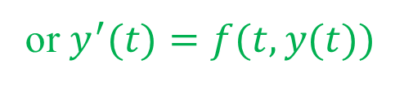
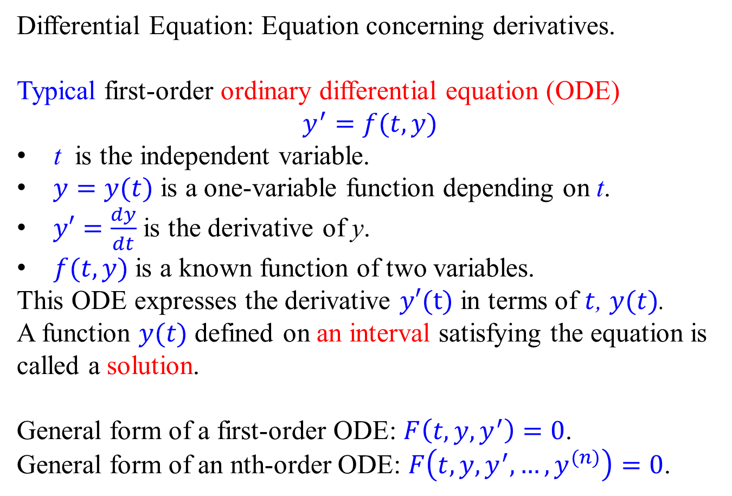
Basic Concepts
Differential Equation: Equation concerning derivatives.
Typical first-order ordinary differential equation (ODE)
$$y^{′}=f(t,y)$$
t is the independent variable.
$y=y(t)$ is a one-variable function depending on t.
$y′=\frac{dy}{dt}$ is the derivative of y.
$f(t, y)$is a known function of two variables.
This ODE expresses the derivative $y′(t)$ in terms of $t$, $y(t)$.
A function $y(t)$ defined on an interval satisfying the equation is called a solution.
General form of a first-order ODE: $F\left(t,y,y^{′}\right)=0$.
General form of an nth-order ODE: $F\left(t,y,y^{′},…,y^{(n)}\right)=0$.
or $y^{′}(t)=f(t,y(t))$

Slide 3
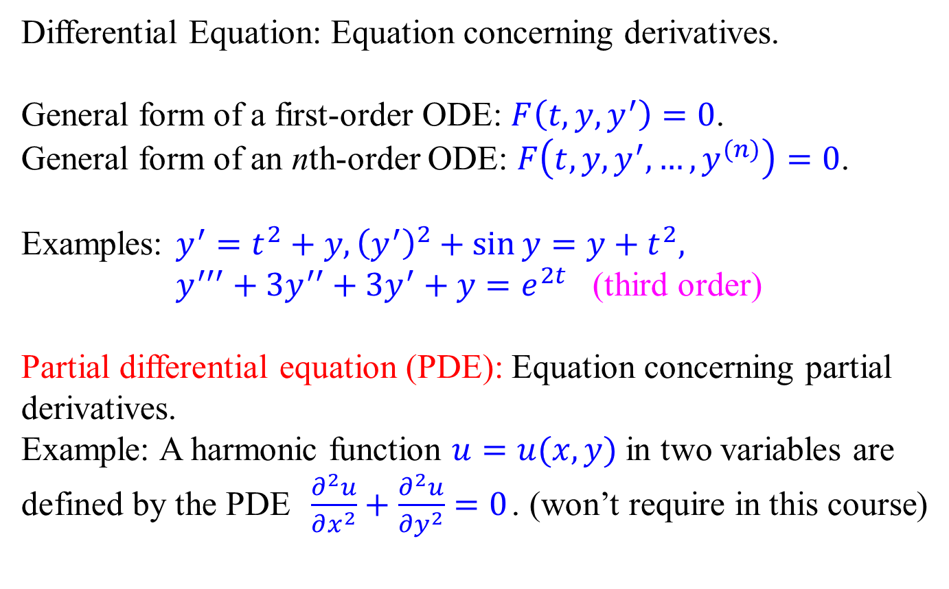
Basic Concepts
Differential Equation: Equation concerning derivatives.
General form of a first-order ODE: $F\left(t,y,y^{′}\right)=0$.
General form of an nth-order ODE: $F\left(t,y,y^{′},…,y^{(n)}\right)=0$.
Examples: $y^{′}=t^{2}+y, {\left(y^{′}\right)}^{2}+\sin{y}=y+t^{2},$
$y^{′′′}+3y^{′′}+3y^{′}+y=e^{2t}$ (third order)
Partial differential equation (PDE): Equation concerning partial derivatives.
Example: A harmonic function $u=u(x,y)$ in two variables are defined by the PDE $\frac{∂^{2}u}{∂x^{2}}+\frac{∂^{2}u}{∂y^{2}}=0$. (won’t require in this course)

Slide 4
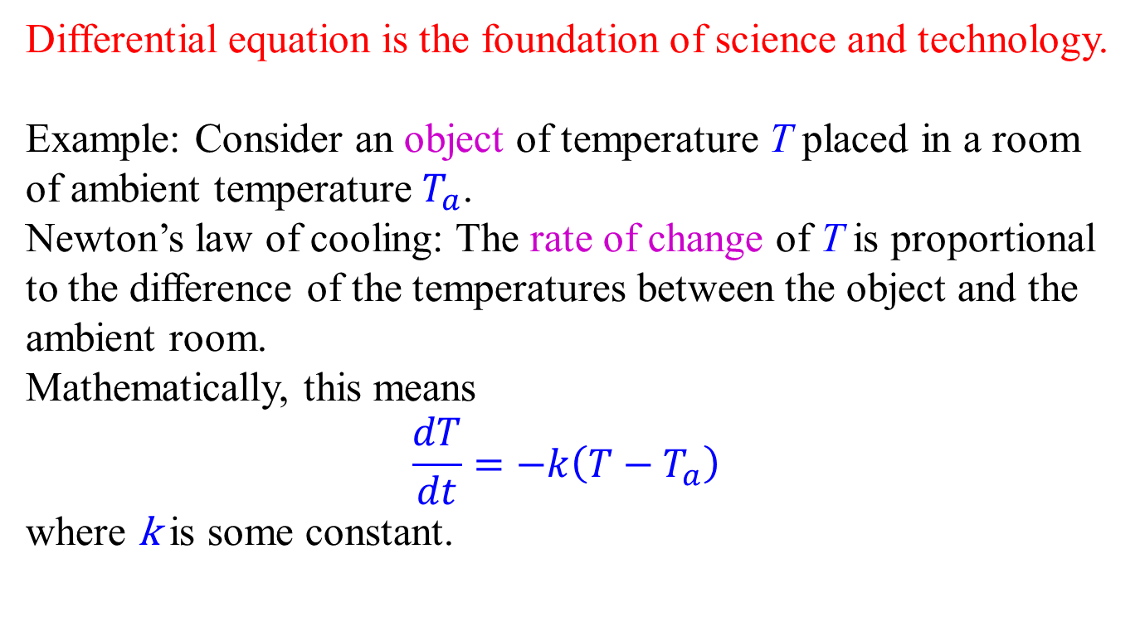
Why study differential equations?
Differential equation is the foundation of science and technology.
Example: Consider an object of temperature T placed in a room of ambient temperature $T_{a}$.
Newton’s law of cooling: The rate of change of T is proportional to the difference of the temperatures between the object and the ambient room.
Mathematically, this means
$$\frac{dT}{dt}=−k\left(T−T_{a}\right)$$
where k is some constant.

Slide 5
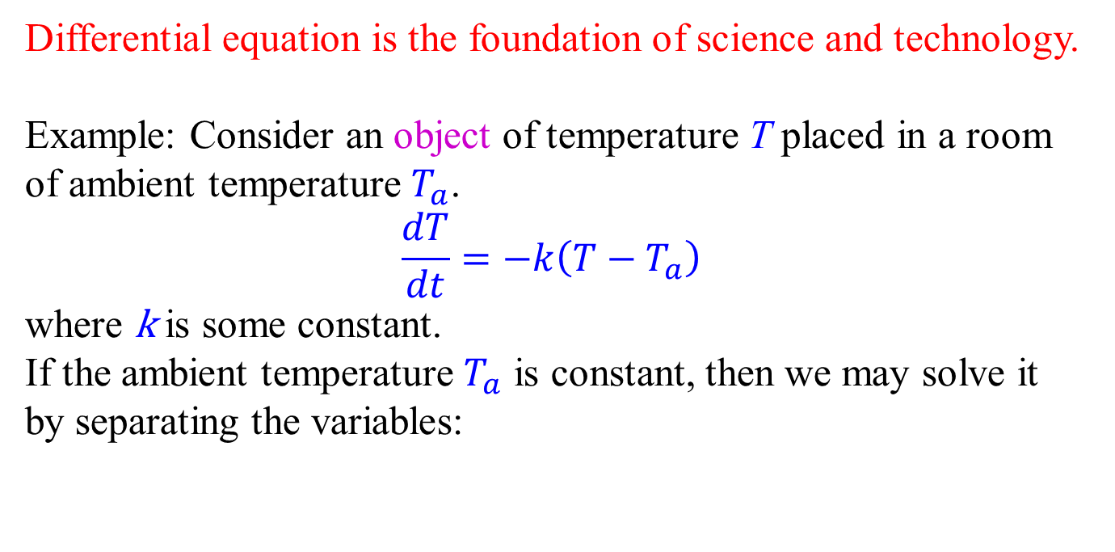
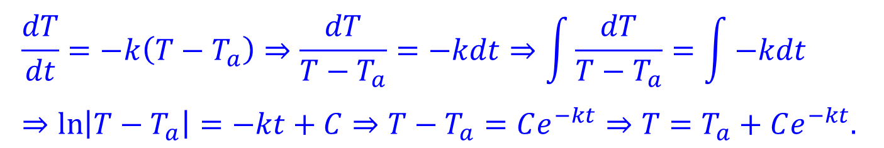
Why study differential equations?
Differential equation is the foundation of science and technology.
Example: Consider an object of temperature T placed in a room of ambient temperature $T_{a}$.
$$\frac{dT}{dt}=−k\left(T−T_{a}\right)$$
where k is some constant.
If the ambient temperature $T_{a}$ is constant, then we may solve it by separating the variables:
$$\frac{dT}{dt}=−k\left(T−T_{a}\right)⇒\frac{dT}{T−T_{a}}=−kdt⇒\int{\frac{dT}{T−T_{a}}}=\int{−kdt} \\ ⇒\ln\left|T−T_{a}\right|=−kt+C⇒T−T_{a}=Ce^{−kt}⇒T=T_{a}+Ce^{−kt}.$$

Slide 6
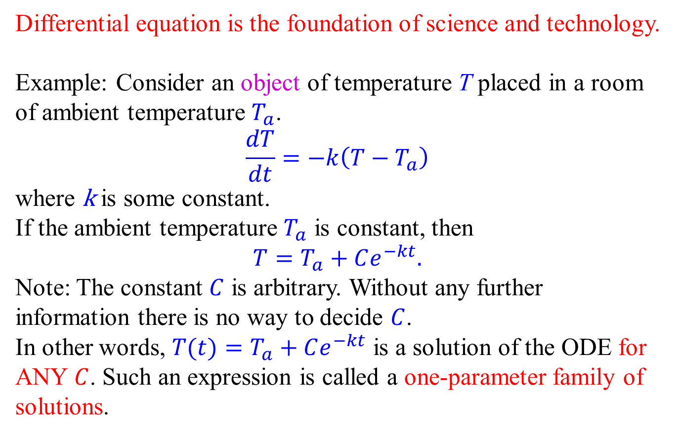
One-parameter family of solutions
Differential equation is the foundation of science and technology.
Example: Consider an object of temperature T placed in a room of ambient temperature $T_{a}$.
$$\frac{dT}{dt}=−k\left(T−T_{a}\right)$$
where k is some constant.
If the ambient temperature $T_{a}$ is constant, then
$$T=T_{a}+Ce^{−kt}.$$
Note: The constant $C$ is arbitrary. Without any further information there is no way to decide $C$.
In other words, $T(t)=T_{a}+Ce^{−kt}$ is a solution of the ODE for ANY $C$. Such an expression is called a one-parameter family of solutions.

Slide 7
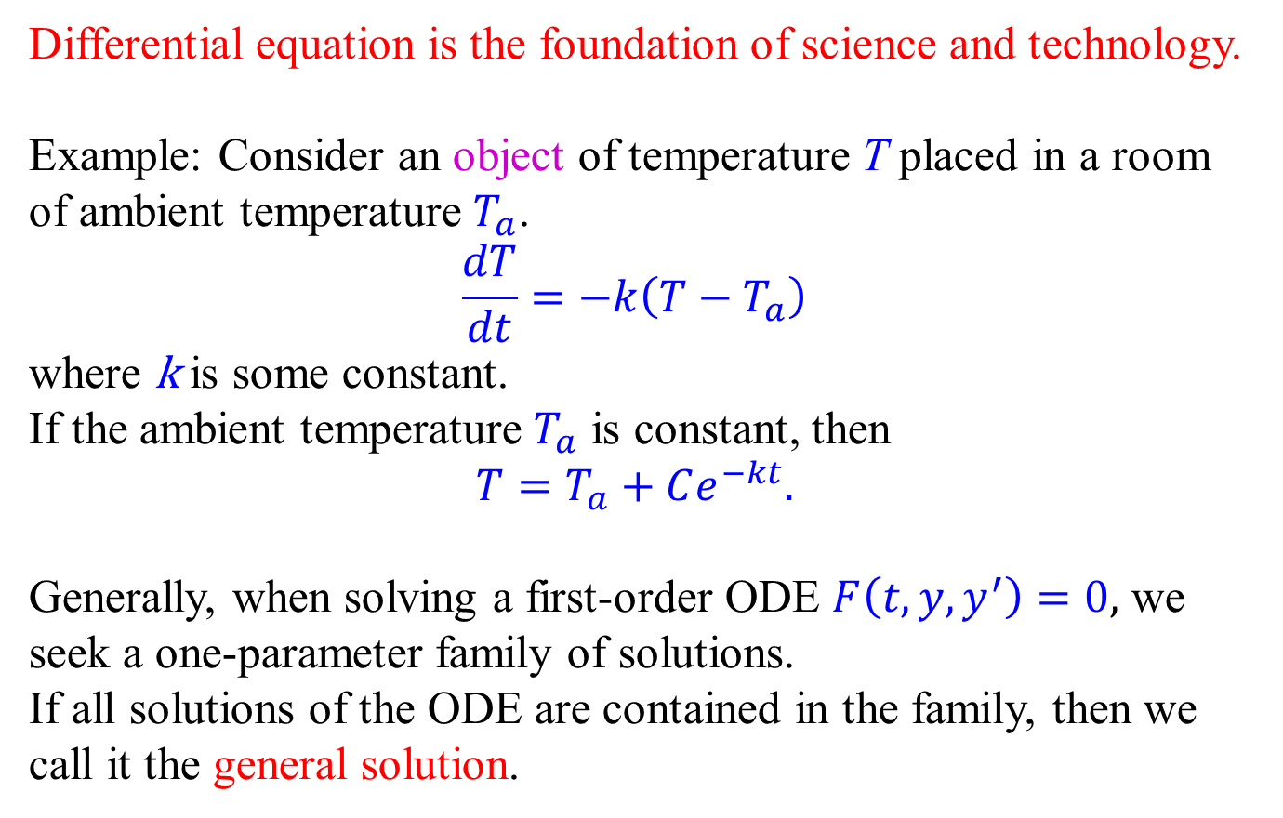
General solution
Differential equation is the foundation of science and technology.
Example: Consider an object of temperature T placed in a room of ambient temperature $T_{a}$.
$$\frac{dT}{dt}=−k\left(T−T_{a}\right)$$
where k is some constant.
If the ambient temperature $T_{a}$ is constant, then
$$T=T_{a}+Ce^{−kt}.$$
Generally, when solving a first-order ODE $F\left(t,y,y^{′}\right)=0,$ we seek a one-parameter family of solutions.
If all solutions of the ODE are contained in the family, then we call it the general solution.

Slide 8
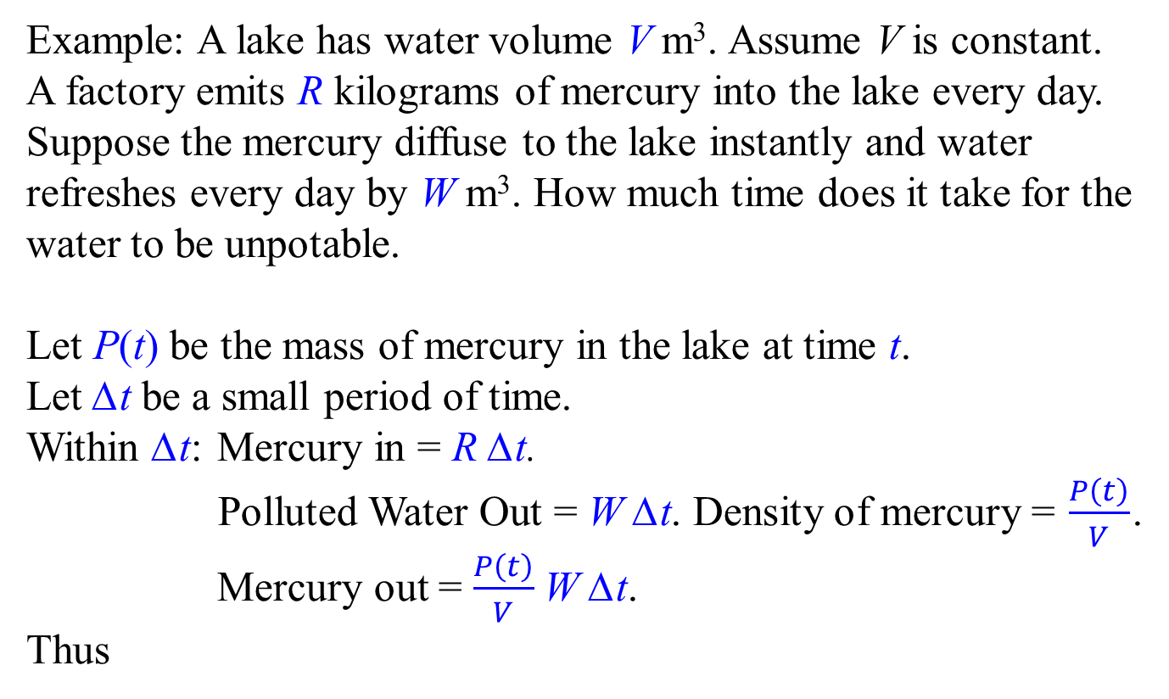

Another example
Example: A lake has water volume V m³. Assume V is constant.
A factory emits R kilograms of mercury into the lake every day.
Suppose the mercury diffuse to the lake instantly and water refreshes every day by W m³. How much time does it take for the water to be unpotable.
Let P(t) be the mass of mercury in the lake at time t.
Let ∆t be a small period of time.
Within ∆t: Mercury in = R ∆t.
Polluted Water Out = W ∆t. Density of mercury = $\frac{P\left(t\right)}{V}$.
Mercury out = $\frac{P\left(t\right)}{V}$W ∆t.
Thus
$$ΔP\left(t\right)=RΔt−\frac{P\left(t\right)}{V}WΔt⇒\frac{ΔP\left(t\right)}{Δt}=R−\frac{P\left(t\right)}{V}$$

Slide 9
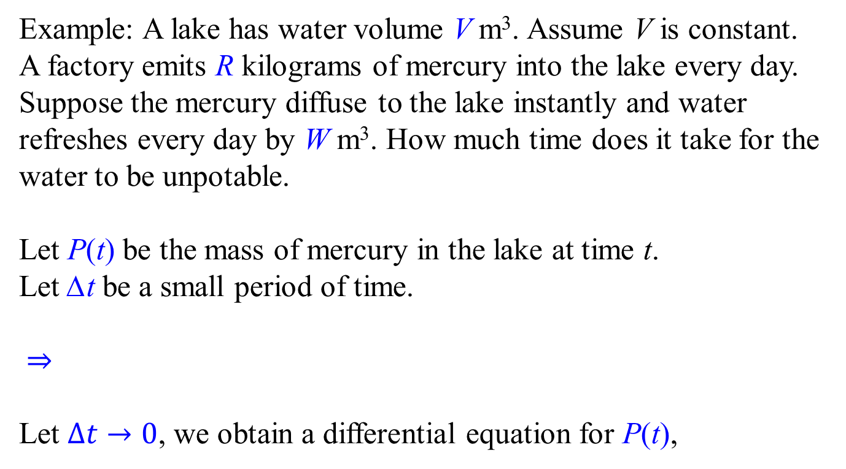

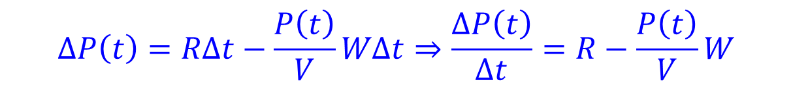
Another example
Example: A lake has water volume V m³. Assume V is constant.
A factory emits R kilograms of mercury into the lake every day.
Suppose the mercury diffuse to the lake instantly and water refreshes every day by W m³. How much time does it take for the water to be unpotable.
Let P(t) be the mass of mercury in the lake at time t.
Let ∆t be a small period of time.
$⇒$
Let $Δt→0$, we obtain a differential equation for P(t),
$$ΔP\left(t\right)=RΔt−\frac{P\left(t\right)}{V}WΔt⇒\frac{ΔP\left(t\right)}{Δt}=R−\frac{P\left(t\right)}{V}W$$
$$\frac{dP\left(t\right)}{dt}=R−\frac{P\left(t\right)}{V}W$$

Slide 10
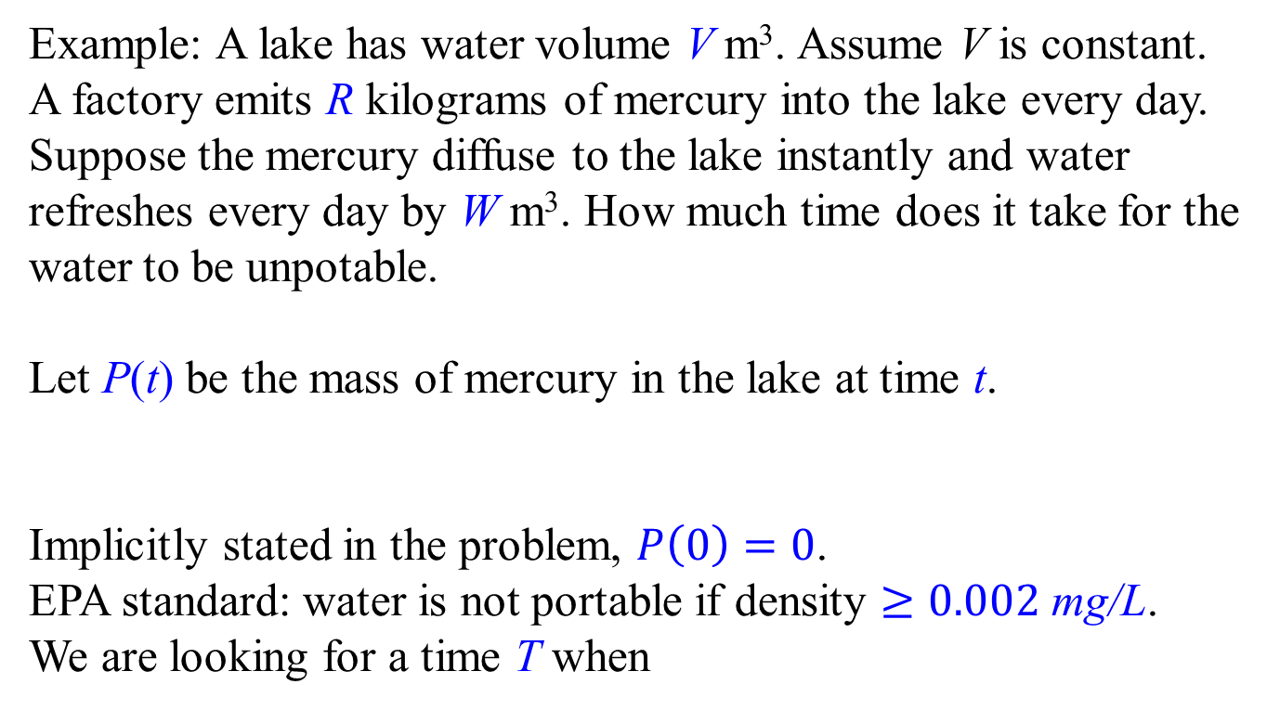


Another example
Example: A lake has water volume V m³. Assume V is constant.
A factory emits R kilograms of mercury into the lake every day.
Suppose the mercury diffuse to the lake instantly and water refreshes every day by W m³. How much time does it take for the water to be unpotable.
Let P(t) be the mass of mercury in the lake at time t.
Implicitly stated in the problem, $P\left(0\right)=0$.
EPA standard: water is not portable if density $≥0.002$ mg/L.
We are looking for a time T when
$$\frac{dP\left(t\right)}{dt}=R−\frac{P\left(t\right)}{V}W$$
$$\frac{P\left(T\right)}{V}≥0.002 {mg}/L=2×{10}^{−6}{kg}/{m^{3}}$$

Slide 11
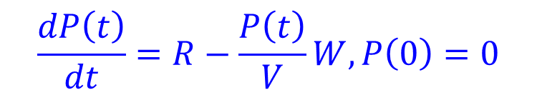
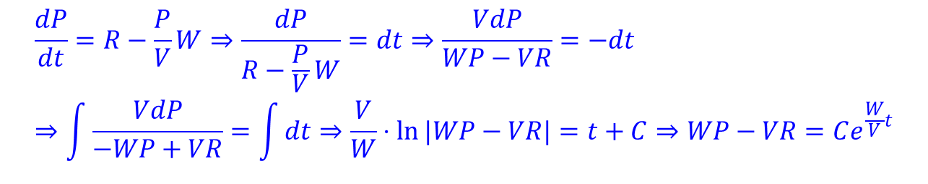
Another example
Example: A lake has water volume V m³. Assume V is constant.
A factory emits R kilograms of mercury into the lake every day.
Suppose the mercury diffuse to the lake instantly and water refreshes every day by W m³. How much time does it take for the water to be unpotable.
Let P(t) be the mass of mercury in the lake at time t.
This differential equation can be solved by separating variables:
$$\frac{dP\left(t\right)}{dt}=R−\frac{P\left(t\right)}{V}W, P\left(0\right)=0$$
$$\frac{dP}{dt}=R−\frac{P}{V}W⇒\frac{dP}{R−\frac{P}{V}W}=dt⇒\frac{VdP}{WP−VR}=−dt \\ ⇒\int{\frac{VdP}{−WP+VR}}=\int{dt}⇒\frac{V}{W}⋅ln{|WP−VR|}=t+C⇒WP−VR=Ce^{\frac{W}{V}t}$$

Slide 12
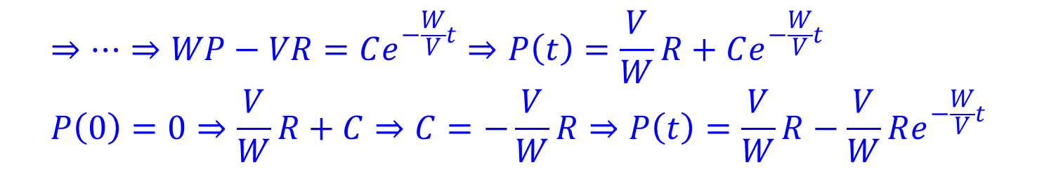
Another example
Example: A lake has water volume V m³. Assume V is constant.
A factory emits R kilograms of mercury into the lake every day.
Suppose the mercury diffuse to the lake instantly and water refreshes every day by W m³. How much time does it take for the water to be unpotable.
Let P(t) be the mass of mercury in the lake at time t.
$$\frac{dP\left(t\right)}{dt}=R−\frac{P\left(t\right)}{V}W, P\left(0\right)=0$$
$$⇒⋯⇒WP−VR=Ce^{−\frac{W}{V}t}⇒P\left(t\right)=\frac{V}{W}R+Ce^{−\frac{W}{V}t} \\ P\left(0\right)=0⇒\frac{V}{W}R+C⇒C=−\frac{V}{W}R⇒P\left(t\right)=\frac{V}{W}R−\frac{V}{W}Re^{−\frac{W}{V}t}$$
The arbitrary constant C is determined
by the initial value P(0) = 0
A definite function as the solution!

Slide 13
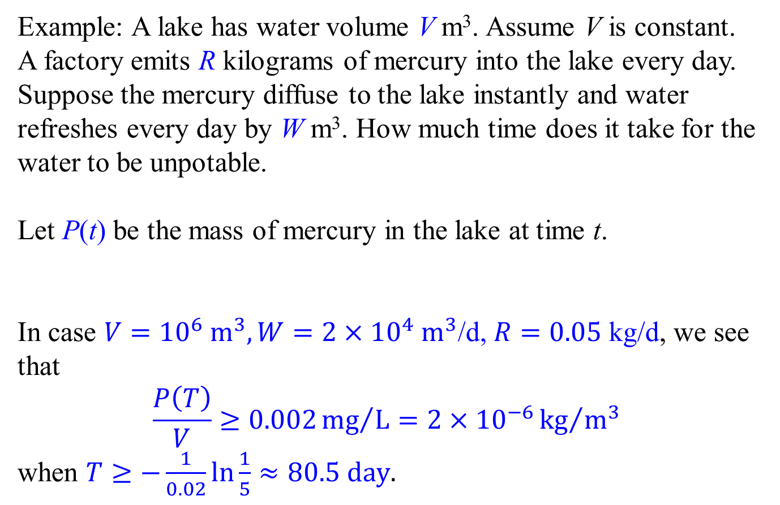
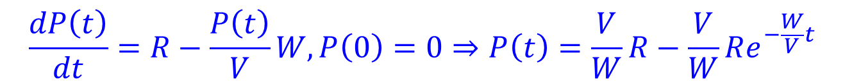
Another example
Example: A lake has water volume V m³. Assume V is constant.
A factory emits R kilograms of mercury into the lake every day.
Suppose the mercury diffuse to the lake instantly and water refreshes every day by W m³. How much time does it take for the water to be unpotable.
Let P(t) be the mass of mercury in the lake at time t.
In case $V={10}^{6} m^{3}, W=2×{10}^{4} m^{3}$/d, $R=0.05$ kg/d, we see that
$$\frac{P\left(T\right)}{V}≥0.002{mg}/L=2×{10}^{−6}{kg}/{m^{3}}$$
when $T≥−\frac{1}{0.02}\ln{\frac{1}{5}}≈80.5 day.$
$$\frac{dP\left(t\right)}{dt}=R−\frac{P\left(t\right)}{V}W, P\left(0\right)=0⇒P\left(t\right)=\frac{V}{W}R−\frac{V}{W}Re^{−\frac{W}{V}t}$$

Slide 14
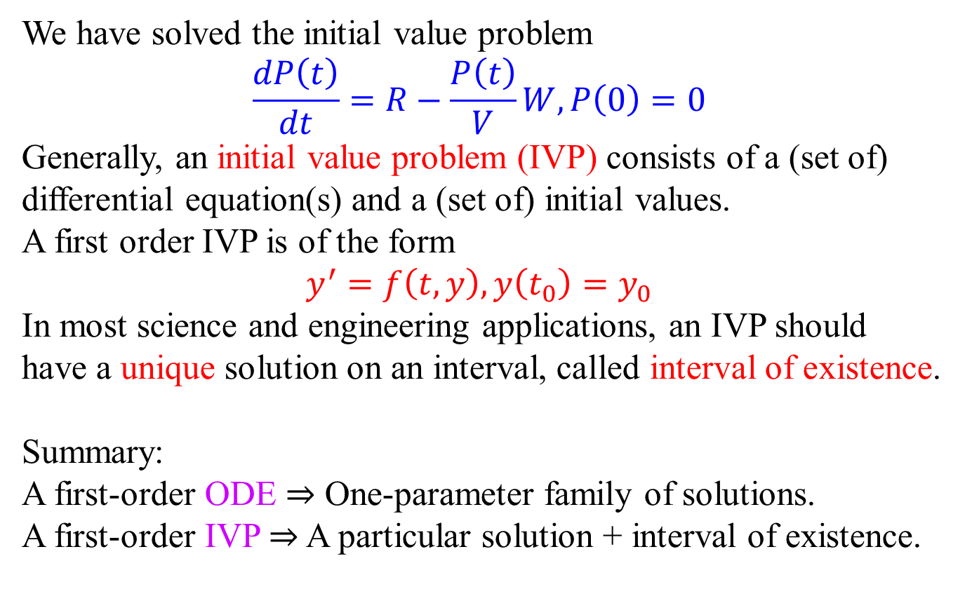
Initial Value Problem
We have solved the initial value problem
$$\frac{dP\left(t\right)}{dt}=R−\frac{P\left(t\right)}{V}W, P\left(0\right)=0$$
Generally, an initial value problem (IVP) consists of a (set of) differential equation(s) and a (set of) initial values.
A first order IVP is of the form
$$y^{′}=f\left(t,y\right), y\left(t_{0}\right)=y_{0}$$
In most science and engineering applications, an IVP should have a unique solution on an interval, called interval of existence.
Summary: A first-order ODE $⇒$ One-parameter family of solutions.
A first-order IVP $⇒$ A particular solution + interval of existence.

Slide 15
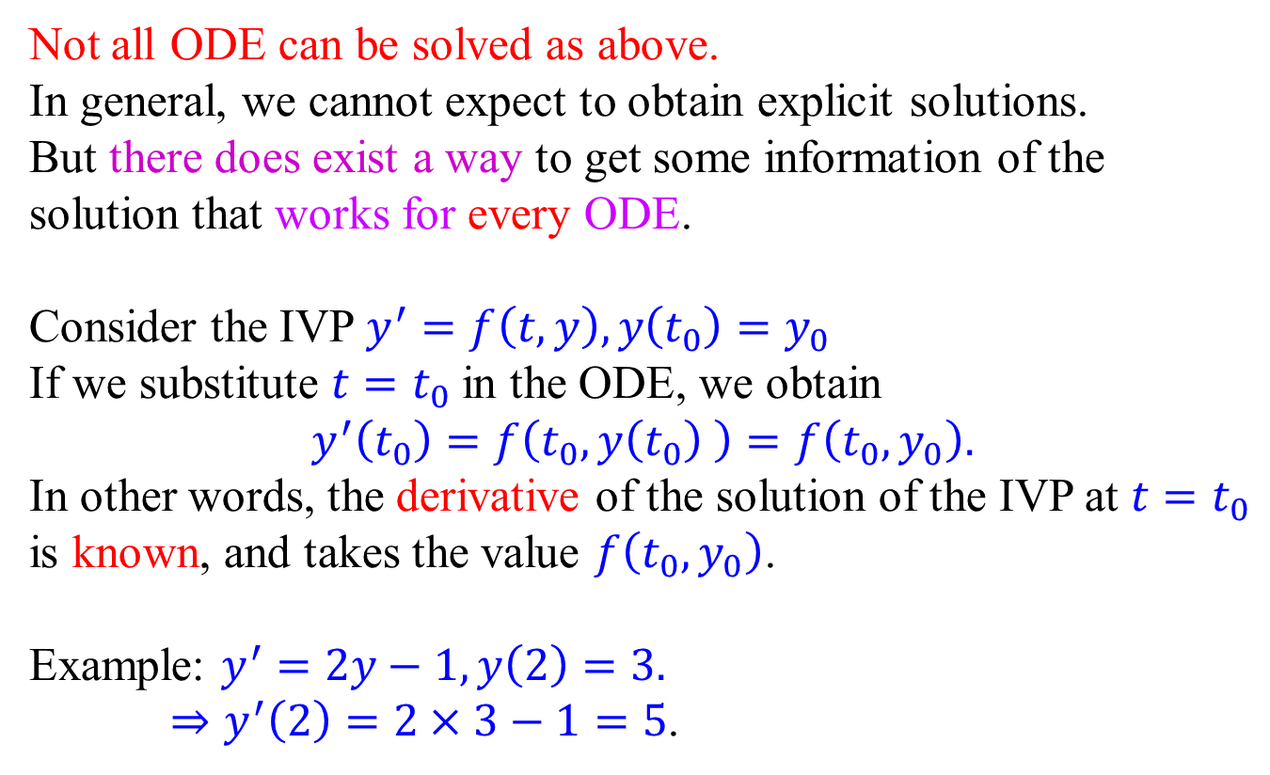
Geometric interpretation
Not all ODE can be solved as above.
In general, we cannot expect to obtain explicit solutions.
But there does exist a way to get some information of the solution that works for every ODE.
Consider the IVP$y^{′}=f\left(t,y\right), y\left(t_{0}\right)=y_{0}$
If we substitute $t=t_{0}$ in the ODE, we obtain
$$y^{′}\left(t_{0}\right)=f\left(t_{0},y\left(t_{0}\right) \right)=f\left(t_{0},y_{0}\right).$$
In other words, the derivative of the solution of the IVP at $t=t_{0}$ is known, and takes the value $f\left(t_{0},y_{0}\right)$.
Example: $y^{′}=2y−1,y\left(2\right)=3.$
$⇒y^{′}\left(2\right)=2×3−1=5$.

Slide 16
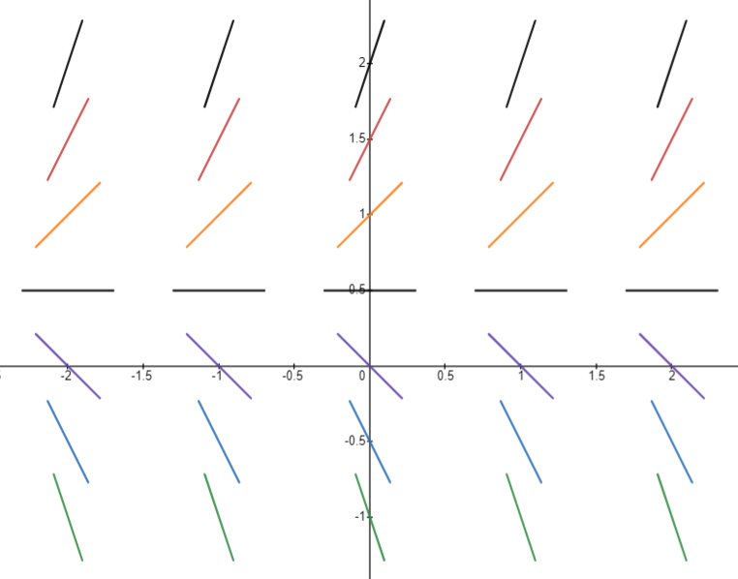
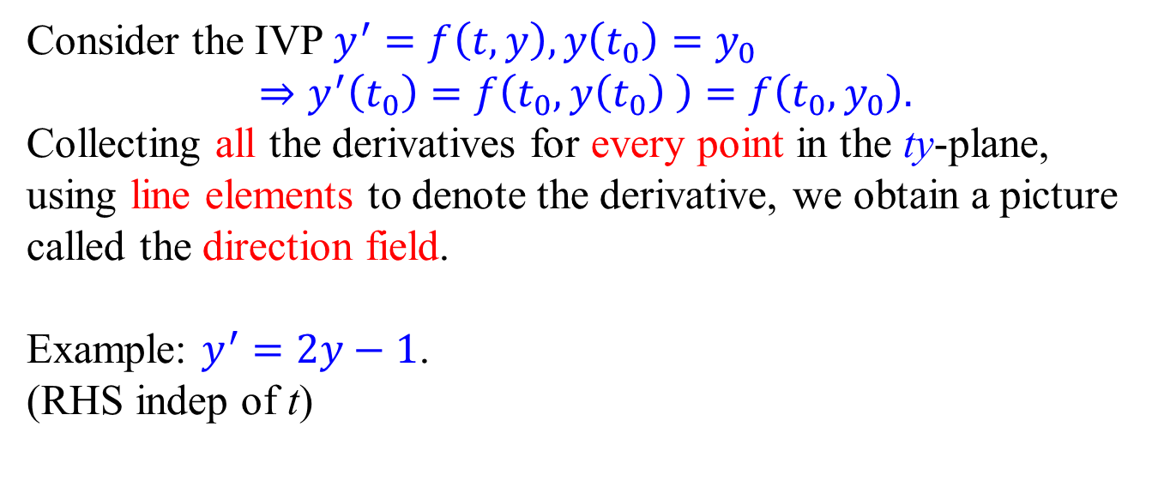
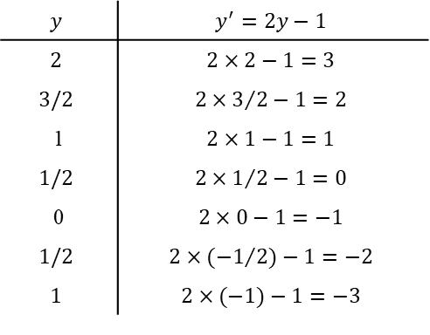
Direction Field
Consider the IVP$y^{′}=f\left(t,y\right), y\left(t_{0}\right)=y_{0}$
$$⇒y^{′}\left(t_{0}\right)=f\left(t_{0},y\left(t_{0}\right) \right)=f\left(t_{0},y_{0}\right).$$
Collecting all the derivatives for every point in the ty-plane, using line elements to denote the derivative, we obtain a picture called the direction field.
Example: $y^{′}=2y−1$.
(RHS indep of t)
$$y$$ | $$y^{′}=2y−1$$
$$2$$ | $$2×2−1=3$$
$$3/2$$ | $$2×3/{2−1=2}$$
1 | $$2×1−1=1$$
$$1/2$$ | $$2×1/{2−1=0}$$
0 | $$2×0−1=−1$$
$$1/2$$ | $$2×{(−1}/2)−1=−2$$
$$1$$ | $$2×(−1)−1=−3$$

Slide 17

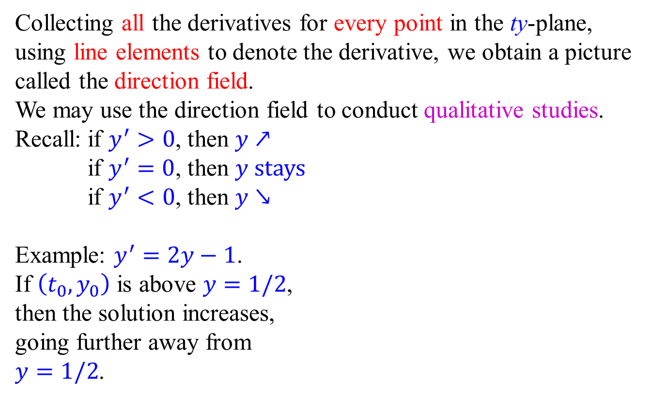
Qualitative method
Collecting all the derivatives for every point in the ty-plane, using line elements to denote the derivative, we obtain a picture called the direction field.
We may use the direction field to conduct qualitative studies.
Recall: if $y^{′}>0$, then $y↗$
if $y^{′}=0$, then $y$ stays
if $y^{′}<0$, then $y↘$
Example: $y^{′}=2y−1$.
If $\left(t_{0}, y_{0}\right)$ is above $y=1/2$, then the solution increases, going further away from $y=1/2$.

Slide 18

Qualitative method
Collecting all the derivatives for every point in the ty-plane, using line elements to denote the derivative, we obtain a picture called the direction field.
We may use the direction field to conduct qualitative studies.
Recall: if $y^{′}>0$, then $y↗$
if $y^{′}=0$, then $y$ stays
if $y^{′}<0$, then $y↘$
Example: $y^{′}=2y−1$.
If $\left(t_{0}, y_{0}\right)$ is below $y=1/2$, then the solution decreases, going further away from $y=1/2$.

Slide 19
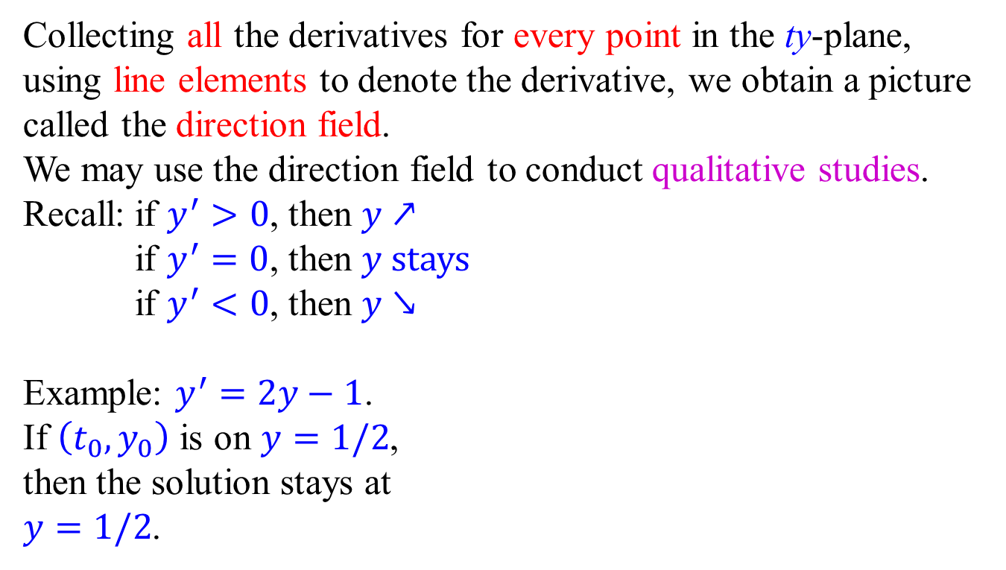
Qualitative method
Collecting all the derivatives for every point in the ty-plane, using line elements to denote the derivative, we obtain a picture called the direction field.
We may use the direction field to conduct qualitative studies.
Recall: if $y^{′}>0$, then $y↗$
if $y^{′}=0$, then $y$ stays
if $y^{′}<0$, then $y↘$
Example: $y^{′}=2y−1$.
If $\left(t_{0}, y_{0}\right)$ is on $y=1/2$, then the solution stays at $y=1/2$.

